Slide 1

Digital Image processing, Spring 2021 An Introduction to Steganography Techniques in the Field of Digital Image Processing, ijesc-2017
Northwestern Polytecnical University
2018380130 – Md Shahedul Islam Khan

Slide 2

Abstract
Steganography is the process of art and science in such a way that no one apart from sender and intended recipient even realizes that the communication is going on. It is also used to authenticate the digital images. Steganography is categorized into spatial domain and frequency domain techniques. This paper presents a cryptography based technique to authenticate the images and can
be used to prevent image forgery

Slide 3
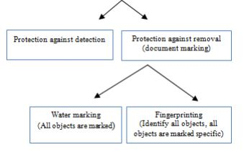
Introduction
Simple steganographic techniques have been in use for hundreds of years, but with the increasing use of files in digital media new techniques for information hiding have become required. This paper examines some early examples of Steganographic process and the general principles behind its usage. Then the authors looked at why it has become such an important issue in recent years. There will then be a discussion of some specific techniques for hiding information in a variety of formats and the attacks that may be used to bypass steganography.

Slide 4
REQUIREMENTS OF HIDING INFORMATI ON DIGITALLY
The integrity of the hidden information after it has been embedded inside the stego object (image, audio, video etc.) must be correct. The secret message must not change in any way, such as additional information being added, loss of information or changes to the secret information after it has been hidden. If secret information is changed during steganography, it would defeat the whole point of the process.
The steganographic object must remain unchanged or almost unchanged to the naked eye. If the stego object changes significantly and can be noticed, it is possible that third party may see that information that is hidden and therefore could attempt to extract or to destroy it.
In steganography, changes in the stego object must have no effect on the secret message. Imagine if you had an illegal copy of an image that you would like to manipulate in various ways. These manipulations can be simple process such as resizing, trimming or rotating the image. The secret message inside the image must survive these manipulations, otherwise the attackers can very easily remove the secret message and the point of steganography will be broken.

Slide 5
REQUIREMENTS OF HIDING INFORMATI ON DIGITALLY
Finally, we always assume that the attacker knows that there is hidden information inside the stego object, So we have to always on alert.

Slide 6
EMBEDDING AND DETECTING A MARK
A simple representation of the generic embedding and then after decoding process in steganography. In this example, a secret image is being embedded inside a cover image to produce the stego image. The first step is to pass both the secret message and the cover message into the encoder. Inside the encoder, several protocols will be implemented to embed the secret information into the cover message. The type of protocol will always depend on what information you are trying to embed and what you are embedding it in. For example, you will use an image protocol to embed information inside images, audio protocol inside audio.
In general the embedding process inserts a mark, M, in an object, I. A key, K, usually produced by a random number generator is used in the embedding process and the resulting marked object, Ĩ, is generated by the mapping: I x K x M → Ĩ

Slide 7
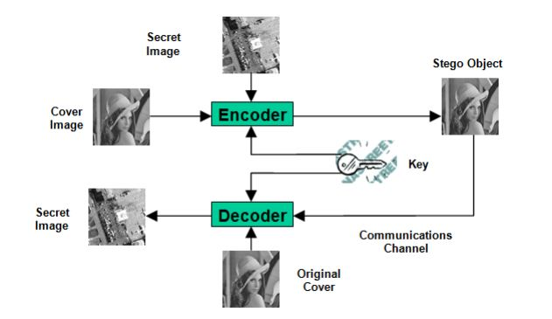
EMBEDDING AND DETECTING A MARK
After passing through the encoder, a stego object will be produced. A stego object is the original cover object with the secret information embedded inside. This object should look almost identical to the cover object as otherwise a third party attacker can see embedded information.

Slide 8
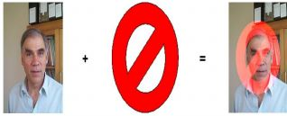
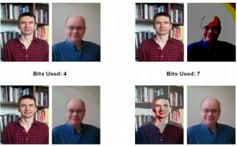
STEGANOGRAPHY USING IMAGES
Various steps and process of steganography are explained below using digital images Simple Watermarking: A very simple and widely used technique for watermarking images is to add a pattern (digital images) on top of an existing image. Usually this pattern is an image itself - a logo or something similar, which distorts the underlying image.
LSB – Least Significant Bit Hiding (Image Hiding): This method is probably the easiest way of hiding information in an image and yet it is surprisingly effective. LSB is basic steganography technique. It works by using the least significant bits of each pixel in one image to hide the most significant bits of another.

Slide 9
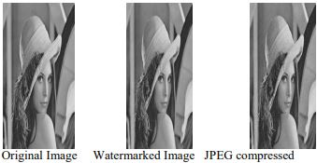
STEGANOGRAPHY USING IMAGES
Direct Cosine Transformation: Most important way of hiding data is by the way of a direct cosine transformation (DCT). The DCT algorithm is one of the main components of the JPEG compression technique as per L.

Slide 10

As steganography is becoming more widely used in digital image processing there are some issues that need to be resolved. A large variety of different techniques with their own advantages and disadvantages are present. Many of them used techniques are not robust enough to prevent detection and removal of embedded data. But the approach the researchers showed with this research paper is praiseworthy.
Conclusion
Thank You!!

Slide 11
Reference
[1]. F. A. P. Petitcolas, R. J. Anderson and M. G. Kuhn, “Information Hiding - A Survey”, Proceedings of the IEEE, vol. 87, no. 7, pp. 1062-1078, July 1999
[2]. C. Cachin, “An Information-Theoretic Model for Steganography”, Proceedings of 2nd Workshop on Informatio Hiding, MIT Laboratory for Computer Science, May 1998
[3]. R. Popa, An Analysis of Steganographic Techniques, The
"Politehnica" University of Timisoara, Faculty of Automatics and Computers, Department of Computer Science and Software Engineering, http:// ad.informatik. uni-freiburg. de/ mitarbeiter/ will/dlib_bookmarks/digital-watermarking/ popa/ popa.pdf, 1998
[4].Herodotus, The Hisories, chap. 5 - The fifth book entitled Terpsichore, 7 - The seventh book entitled Polymnia, J. M. Dent & Sons, Ltd, 1992
[5].Second Lieutenant J. Caldwell, Steganography, United States Air Force, http://www.stsc.hill.af.mil/ crosstalk/2 003/ 06 /caldwell.pdf, June 2003
[6].BBC News, Piracy blamed for CD sales slump, BBC, http://news.bbc.co.uk/1/hi/entertainment/new_media/1841768.stm, February 2002
[7].M. Kwan, The Snow Home Page, http://www. darkside.com. au/snow/index.html, March 2001
[8].Compris Intelligence, TextHide, Compris Intelligence , http://www.compris.com/TextHide/en/
[9].P. Wayner, SpamMimic, http://www.spammimic.com, 2003
[10]. R. Hipschman, The Secret Language, Exploratorium, http://www.exploratorium.edu/ronh/secret/secret.html, 1995
[11]. S. Inoue, K. Makino, I. Murase, O. Takizawa, T. Matsumoto and H. Nakagawa, A Proposal on Information Hiding Methods using XML, http://takizawa.gr. jp/lab/nlp_xml.pdf
[12]. M. D. Swanson, B. Zhu and A. H. Tewfik, “Robust Data Hiding for Images”, IEEE Digital Signal Processing Workshop, pp. 37-40, [13].L.Leurs,JPEGCompression,http://www.prepressure.com/techno/compressionjpeg.htm,2001
[14]. A. K. Chao and C. Chao, Robust Digital Watermarking & Data Hiding, Image Systems Engineering Program, Stanford University, http://ise.stanford.edu/ class/ee368a_ proj00/ project7/index.html,May2000

